Slide 1
Introduction to Java

Slide 2

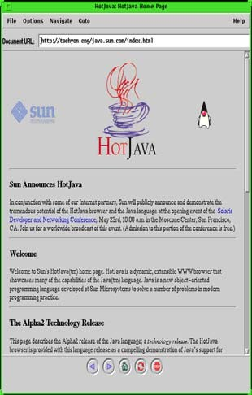





Introduction
●
Java is a very powerful language that has generated a lot of interest in the last years.
Java
The Star 7 device
The HotJava browser
Oak

Slide 3
Introduction
●
It is a general purpose concurrent object oriented language, with a syntax similar to C and C++, but omitting features that are complex and unsafe.
C++ Java
Backward compatile con C
Backward compatibility with previous Java versions
Developer productivity Protects the programmer
Memory access through objects Explicit operation
Type safety Object oriented
Meaning of operators immutable
Execution efficiency Trusts the programmer
Arbitrary memory access possible Concise expression
Can arbitrarily override types
Procedural or object oriented Operator overloading

Slide 4
Introduction
●
The world wide web has popularized the use of Java, because programs can be transparently downloaded with web pages and executed in any computer with a Java capable browser.
●
A Java application is a standalone Java program that can be executed independently of any web browser.
●
A Java applet is a program designed to be executed under a Java capable browser.

Slide 5



The Java platform
●
Java programs are compiled to Java byte-codes, a kind of machine independent representation.
The program is then executed by an interpreter called the Java Virtual Machine (JVM).
Test.java
Test.class
Interpreter (JVM)
Compiler

Slide 6







The Java platform
●
The compiled code is independent of the architecture of the computer.
The price to pay is a slower execution.
●
Test.java
Test.class
Interpreter (JVM)
Interpreter (JVM)
Compiler
Interpreter (JVM)

Slide 7
A first example
/**
Hello World Application
Our first example
*/
public class HelloWorld {
public static void main(String[] args) { System.out.println("Hello World!"); // display output
}
}
$ javac HelloWorld.java
$ ls HelloWorld.class HelloWorld.java
$ java HelloWorld Hello World

Slide 8
Documentation
●
The javadoc utility can be used to generate automatically documentation for the class.
/**
My first <b>Test</b>
@author Carlos Kavka
@version 1.1
*/
public class HelloWorld {
/**
@param args the command line arguments
@since 1.0
*/
public static void main(String[] args) { System.out.println("Hello World");
}
}

Slide 9
Fundamental types
●
Java provides ten fundamental types:
integers: byte, short, int and long floating point: float and double. characters: char.
boolean void String
–
–
–
–
–
–

Slide 10
Variables
●
The variables are declared specifying its type and name, and initialized in the point of declaration, or later with the assignment expression:
int x;
double | f | = 0.33;
char c | = | ’a’;
String | s | = "abcd";
x = 55;

Slide 11
Literals
●
The integer values can be written in decimal, hexadecimal, octal and long forms:
int x = 34; int y = 0x3ef; int z = 0772;
// decimal value
// hexadecimal
// octal
long m = 240395922L; // long
●
The floating point values are of type double by default:
double d = 6.28; float f = 6.28F;
// 6.28 is a double value
// 6.28F is a float value

Slide 12
Literals
●
The character values are specified with the standard C notation, with extensions for Unicode values:
char c = ’a’; char d = ’\n’; char e = ’\u2122’
// character lowercase a
// newline
// unicode character (TM)
●
The boolean values are true and false:
boolean ready = true; // boolean value true boolean late = false; // boolean value false

Slide 13
Constants
●
Constants are declared with the word final in front. The specification of the initial value is compulsory:
final | double pi = 3.1415; | // | constant PI
final | int maxSize = 100; | // | integer constant
final | char lastLetter = ’z’; | // | last lowercase letter
final | String word = "Hello"; | // | a constant string

Slide 14
Expressions
●
Java provides a rich set of expressions:
Arithmetic Bit level Relational Logical
Strings related
–
–
–
–
–

Slide 15
Arithmetic expressions
●
Java provides the usual set of arithmetic operators:
– addition (+) subtraction (-) division (/) multiplication (*) modulus (%)
–
–
–
–

Slide 16
Arithmetic operators
class Arithmetic {
public static void main(String[] args) { int x = 12;
int y = 2 * x; System.out.println(y); int z = (y - x) % 5;
System.out.println(z); final float pi = 3.1415F; float f = pi / 0.62F; System.out.println(f);
}
}
$ java Arithmetic 24
2
5.0669355

Slide 17
Arithmetic operators
●
Shorthand operators are provided:
class ShortHand {
public static void main(String[] args) { int x = 12;
x += 5; // x = x + 5 System.out.println(x);
x *= 2; // x = x * 2 System.out.println(x);
}
}
$ java ShortHand 17
34

Slide 18
Arithmetic operators
●
Pre and post operators are also provided:
class Increment {
public static void main(String[] args) { int x = 12,y = 12;
System.out.println(x++); // printed and then incremented System.out.println(x);
System.out.println(++y); // incremented and then printed System.out.println(y);
}
}
$ java Increment
12 13 13 13

Slide 19
Relational expressions
●
Java provides the following relational operators:
– equivalent (==) not equivalent (!=) less than (<) greater that (>)
less than or equal (<=) greater than or equal (>=)
–
–
–
–
–
●
Important: relational expressions always return a
boolean value.

Slide 20
Relational Expressions
class Boolean {
public static void main(String[] args) { int x = 12,y = 33;
System.out.println(x < y); System.out.println(x != y - 21);
boolean test = x >= 10; System.out.println(test);
}
}
$ java Boolean true
false
true

Slide 21
Bit level operators
●
Java provides the following operators:
– and (&) or (|)
not(˜)
shift left (<<)
shift right with sign extension (>>) shift right with zero extension (>>>).
–
–
–
–
–
●
Important: char, short and byte arguments are promoted to int before and the result is an int.

Slide 22
Bit level operators
class Bits {
public static void main(String[] args) {
int x = 0x16; int y = 0x33;
// 00000000000000000000000000010110
// 00000000000000000000000000110011
System.out.println(x & y);// 00000000000000000000000000010010
System.out.println(x | y);// 00000000000000000000000000110111
System.out.println(˜x);
// 11111111111111111111111111101001
x &= 0xf; System.out.println(x);
// 00000000000000000000000000000110
// 00000000000000000000000000000110
short s = 7; System.out.println(˜s);
// 0000000000000111
// 11111111111111111111111111111000
}
}

Slide 23
Bit level operators
class Bits2 {
public static void main(String[] args) {
int x = 0x16;
//00000000000000000000000000010110
System.out.println(x << 3);//00000000000000000000000010110000
int y = 0xfe; y >>= 4;
System.out.println(y);
//00000000000000000000000011111110
//00000000000000000000000000001111
//00000000000000000000000000001111
x = 9;
//00000000000000000000000000001001
System.out.println(x >> 3);//00000000000000000000000000000001 System.out.println(x >>>3);//00000000000000000000000000000001
x = -9;
//11111111111111111111111111110111
System.out.println(x >> 3);//11111111111111111111111111111110 System.out.println(x >>>3);//00011111111111111111111111111110
}
}

Slide 24
Logical operators
●
Java provides the following operators:
– and (&&) or (||) not(!)
–
–
●
Important: The logical operators can only be applied to boolean expressions and return a boolean value.

Slide 25
Logical operators
class Logical {
public static void main(String[] args) { int x = 12,y = 33;
double d = 2.45,e = 4.54;
System.out.println(x < y && d < e); System.out.println(!(x < y));
boolean test = ’a’ > ’z’; System.out.println(test || d - 2.1 > 0);
}
}
$ java Logical true
false
true

Slide 26
String operators
●
Java provides many operators for Strings:
Concatenation (+)
many more...
●
Important: If the expression begins with a string and uses the + operator, then the next argument is converted to a string.
●
Important: Strings cannot be compared with == and !=.

Slide 27
String operators
class Strings {
public static void main(String[] args) {
String s1 = "Hello" + " World!"; System.out.println(s1);
int i = 35,j = 44;
System.out.println("The value of i is " + i +
" and the value of j is " + j);
}
}
$ java Strings Hello World!
The value of i is 35 and the value of j is 44

Slide 28
String operators
class Strings2 {
public static void main(String[] args) {
String s1 = "Hello"; String s2 = "Hello";
System.out.println(s1.equals(s2)); System.out.println(s1.equals("Hi"));
}
}
$ java Strings2 true
false

Slide 29
Casting
●
Java performs a automatic type conversion in the values when there is no risk for data to be lost.
class TestWide {
public static void main(String[] args) {
 | int a = ’x’; | // ’x’ is a character
 | long b = 34; | // 34 is an int
 | float c = 1002; | // 1002 is an int
 | double d = 3.45F; | // 3.45F is a float
}
}

Slide 30
Casting
●
In order to specify conversions where data can be lost it is necessary to use the cast operator.
class TestNarrow {
public static void main(String[] args) {
long a = 34; int b = (int)a;
double d = 3.45;
float f = (float)d;
// a is a long
// d is a double
}
}

Slide 31
Control structures
●
Java provides the same set of control structures than C.
●
Important: the value used in the conditional expressions must be a boolean.

Slide 32
Control structures (if)
class If {
public static void main(String[] args) { char c = ’x’;
if ((c >= ’a’ && c <= ’z’) || (c >= ’A’ && c <= ’Z’)) System.out.println("letter: " + c);
else
if (c >= ’0’ && c <= ’9’) System.out.println("digit: " + c);
else {
System.out.println("the character is: " + c); System.out.println("it is not a letter"); System.out.println("and it is not a digit");
}
}
}
$ java If letter: x

Slide 33
Control structures (while)
class While {
public static void main(String[] args) { final float initialValue = 2.34F; final float step = 0.11F;
final float limit = 4.69F; float var = initialValue;
int counter = 0; while (var < limit) {
var += step;
counter++;
}
System.out.println("Incremented " + counter + " times");
}
}
$ java While Incremented 22 times

Slide 34
Control structures (for)
class For {
public static void main(String[] args) { final float initialValue = 2.34F; final float step = 0.11F;
final float limit = 4.69F; int counter = 0;
for (float var = initialValue;var < limit;var += step) counter++;
System.out.println("Incremented " + counter + " times");
}
}
$ java For Incremented 22 times

Slide 35
Control structures (break/continue)
class BreakContinue {
public static void main(String[] args) {
for (int counter = 0;counter < 10;counter++) {
// start a new iteration if the counter is odd if (counter % 2 == 1) continue;
// abandon the loop if the counter is equal to 8 if (counter == 8) break;
// print the value System.out.println(counter);
}
System.out.println("done.");
}
}
$ java BreakContinue
0 2 4 6 done.

Slide 36
Control structures (switch)
class Switch {
public static void main(String[] args) {
boolean leapYear = true; int days = 0;
for(int month = 1;month <= 12;month++) { switch(month) {
case 1: // months with 31 days
case 3:
case 5:
case 7:
case 8:
case 10:
case 12:
days += 31; break;

Slide 37
Control structures (switch)
case 2: // February is a special case if (leapYear)
days += 29;
else
days += 28; break;
default: // it must be a month with 30 days days += 30;
break;
}
}
System.out.println("number of days: " + days);
}
}
$ java Switch number of days: 366

Slide 38
Arrays
●
Arrays can be used to store a number of elements of the same type:
int[] a;
float[] b; String[] c;
// an unitialized array of integers
// an unitialized array of floats
// an unitialized array of Strings
●
Important: The declaration does not specify a size. However, it can be inferred when initialized:
int[] a = {13,56,2034,4,55};
float[] b = {1.23F,2.1F};
String[] c = {"Java","is","great"};
// size: 5
// size: 2
// size: 3

Slide 39
Arrays
●
Other possibility to allocate space for arrays consists in the use of the operator new:
int i = 3,j = 5; double[] d;
// unitialized array of doubles
d = new double[i+j];
// array of 8 doubles
●
Components of the arrays are initialized with default values:
– 0 for numeric type elements, '\0' for characters
null for references.
–
–

Slide 40
Arrays
●
Components can be accessed with an integer index with values from 0 to length minus 1.
a[2] = 1000; // modify the third element of a
●
Every array has a member called length that can be used to get the length of the array:
int len = a.length; // get the size of the array

Slide 41
Arrays
class Arrays {
public static void main(String[] args) { int[] a = {2,4,3,1};
// compute the summation of the elements of a int sum = 0;
for(int i = 0;i < a.length;i++) sum += a[i];
// create an array of the size computed before float[] d = new float[sum];
for(int i = 0;i < d.length;i++) d[i] = 1.0F / (i+1);
// print values in odd positions for(int i = 1;i < d.length;i += 2)
System.out.println("d[" + i + "]=" + d[i]);
}
}
$ java Arrays
d[1]=0.5 d[3]=0.25 d[5]=0.16666667 d[7]=0.125 d[9]=0.1

Slide 42
Command line arguments
●
We have seen that the method main has to be defined as follows:
public static void main(String[] args)
●
Through the array argument, the program can get access to the command line arguments

Slide 43
Command line arguments
class CommandArguments {
public static void main(String[] args) { for(int i = 0;i < args.length;i++)
System.out.println(args[i]);
}
}
$ java Hello World | CommandArguments | Hello World
$ java | CommandArguments
$ java I have 25 cents | CommandArguments | I have 25 cents
"Hello"
"World"
args
[0][1]

Slide 44
Command line arguments
class Add {
public static void main(String[] args) { if (args.length != 2) {
System.out.println("Error"); System.exit(0);
}
int arg1 = Integer.parseInt(args[0]); int arg2 = Integer.parseInt(args[1]); System.out.println(arg1 + arg2);
}
}
$ java Add 234 12
246
"234"
"24"
"12"
$ java Add 24 Error
args
args
[0][1]
[0]

Slide 45
Classes
●
A class is defined in Java by using the class keyword and specifying a name for it:
class Book {
}
●
New instances of the class can be created with new:
Book b1 = new Book(); Book b2 = new Book();
b3 = new Book();

Slide 46
Classes
●
Inside a class it is possible to define:
data elements, usually called instance variables
functions, usually called methods
●
Class Book with instance variables:
class Book { String title; String author;
int numberOfPages;
}
●
The instance variables can be accessed with the dot notation.

Slide 47
Classes
title author
"Thinking in Java"
class Book { String title; String author;
int numberOfPages;
}
"Bruce Eckel"
numberOfPages
1129
b
class ExampleBooks {
public static void main(String[] args) {
Book b = new Book();
b.title = "Thinking in Java"; b.author = "Bruce Eckel"; b.numberOfPages = 1129;
System.out.println(b.title + " : " + b.author +
" : " + b.numberOfPages);
}
}

Slide 48
Constructors
●
The constructors allow the creation of instances that are properly initialized.
●
A constructor is a method that:
– has the same name as the name of the class to which it belongs
has no specification for the return value, since it returns nothing.
–

Slide 49
Constructors
class Book { String title; String author;
int numberOfPages;
Book(String tit,String aut,int num) { title = tit;
author = aut; numberOfPages = num;
}
}
class ExampleBooks2 {
public static void main(String[] args) {
Book b = new Book("Thinking in Java","Bruce Eckel",1129); System.out.println(b.title + " : " + b.author +
" : " + b.numberOfPages);
}
}

Slide 50
Default constructors
●
Java provides a default constructor for the classes.
b = new Book();
●
This default constructor is only available when no constructors are defined in the class.

Slide 51
Multiple constructors
●
It is possible to define more than one constructor for a single class, only if they have different number of arguments or different types for the arguments.
a = | new | Book("Thinking in Java","Bruce | Eckel",1129);
b = | new | Book("Thinking in Java","Bruce | Eckel",1129,"0-13-027363");
title author
"Thinking in Java"
title author
"Thinking in Java"
"Bruce Eckel"
"Bruce Eckel"
a
numberOfPages
1129
b
numberOfPages
1129
ISBN
"unknown"
ISBN
"0-13-027363-5"

Slide 52
Multiple constructors
class Book { String title; String author;
int numberOfPages; String ISBN;
Book(String tit,String aut,int num) { title = tit; author = aut; numberOfPages = num;
ISBN = "unknown";
}
Book(String tit,String aut,int num,String isbn) { title = tit; author = aut;
numberOfPages = num;
ISBN = isbn;
}
}

Slide 53
Multiple constructors
class ExampleBooks3 {
public static void main(String[] args) { Book b1,b2;
b1 = new Book("Thinking in Java","Bruce Eckel",1129); System.out.println(b1.title + " : " + b1.author +
" : " + b1.numberOfPages + " : " + b1.ISBN); b2 = new Book("Thinking in Java","Bruce Eckel",1129,
"0-13-027363-5");
System.out.println(b2.title + " : " + b2.author +
" : " + b2.numberOfPages + " : " + b2.ISBN);
}
}
$ java ExampleBooks3
Thinking in Java : Bruce Eckel : 1129 : unknown Thinking in Java : Bruce Eckel : 1129 : 0-13-027362-5

Slide 54
Methods
●
A method is used to implement the messages that an instance (or a class) can receive.
●
It is implemented as a function, specifying arguments and type of the return value.
It is called by using the dot notation.
●

Slide 55
Methods
class Book { String title; String author;
int numberOfPages; String ISBN;
...
// compute initials of author's name public String getInitials() {
String initials = "";
for(int i = 0;i < author.length();i++) { char currentChar = author.charAt(i);
if (currentChar >= ’A’ && currentChar <=’Z’) initials = initials + currentChar + ’.’;
}
return initials;
}
}

Slide 56
Methods
class ExampleBooks4 {
public static void main(String[] args) { Book b;
b = new Book("Thinking in Java","Bruce Eckel",1129); System.out.println("Initials: " + b.getInitials());
}
}
$ java ExampleBooks4 Initials: B.E.
title author
"Thinking in Java"
"Bruce Eckel"
b
numberOfPages
1129
ISBN
"unknown"

Slide 57
Methods
class ExampleBooks5 {
public static void main(String[] args) {
Book[] a = new Book[3];
a[0] = new Book("Thinking in Java","Bruce Eckel",1129); a[1] = new Book("Java in a nutshell","David Flanagan",353); a[2] = new Book("Java network programming",
"Elliott Rusty Harold",649);
for(int i = 0;i < a.length;i++) System.out.println("Initials: " + a[i].getInitials());
}
}
$ java ExampleBooks5 Initials: B.E. Initials: D.F. Initials: E.R.H.

Slide 58
Methods
title author
"Thinking in Java"
Initials: D.F.
"Bruce Eckel"
title author
"Java in a nutshell"
numberOfPages
1129
"David Flanagan"
ISBN
"unknown"
numberOfPages
353
Initials:
B.E.
ISBN
"unknown"
title author
"Java network programming"
"Elliot Rusty Harold"
numberOfPages
649
ISBN
"unknown"
a
Initials: E.R.H.

Slide 59
Equality and equivalence
class ExampleBooks6 {
public static void main(String[] args) {
Book b1,b2;
b1 = new Book("Thinking in Java","Bruce Eckel",1129); b2 = new Book("Thinking in Java","Bruce Eckel",1129);
if (b1 == b2)
System.out.println("The two books are the same"); else
System.out.println("The two books are different");
}
}
$ java ExampleBooks6
The two books are different

Slide 60
Equality and equivalence
title author
"Thinking in Java"
title author
"Thinking in Java"
"Bruce Eckel"
"Bruce Eckel"
b1
numberOfPages
1129
b2
numberOfPages
1129
ISBN
"unknown"
ISBN
"0-13-027363-5"
b1 | = new Book("Thinking | in | Java","Bruce | Eckel",1129);
b2 if | = new Book("Thinking (b1 == b2) | in | Java","Bruce | Eckel",1129);
System.out.println("The two books are the same"); else
System.out.println("The two books are different");

Slide 61
Equality and equivalence
class ExampleBooks6a {
public static void main(String[] args) {
Book b1,b2;
b1 = new Book("Thinking in Java","Bruce Eckel",1129); b2 = b1;
if (b1 == b2)
System.out.println("The two books are the same"); else
System.out.println("The two books are different");
}
}
$ java ExampleBooks6a
The two books are the same

Slide 62
Equality and equivalence
title author
"Thinking in Java"
"Bruce Eckel"
b1
numberOfPages
1129
ISBN
"unknown"
b2
b1 | = new Book("Thinking | in Java","Bruce | Eckel",1129);
b2 if | = b1; (b1 == b2)
System.out.println("The two books are the same"); else
System.out.println("The two books are different");

Slide 63
Equality and equivalence
class Book { String title; String author;
int numberOfPages; String ISBN;
...
// compare two books
public boolean equals(Book b) { return (title.equals(b.title) &&
author.equals(b.author) &&
numberOfPages == b.numberOfPages && ISBN.equals(b.ISBN));
}
}

Slide 64
Equality and equivalence
class ExampleBooks7 {
public static void main(String[] args) {
Book b1,b2;
b1 = new Book("Thinking in Java","Bruce Eckel",1129); b2 = new Book("Thinking in Java","Bruce Eckel",1129);
if (b1.equals(b2))
System.out.println("The two books are the same"); else
System.out.println("The two books are different");
}
}
$ java ExampleBooks7
The two books are the same

Slide 65
Class variables
●
Class variables are fields that belong to the class and do not exist in each instance.
●
It means that there is always only one copy of this data member, independent of the number of the instances that were created.

Slide 66
Class variables
class Book { String title; String author;
int numberOfPages; String ISBN;
static String owner;
...
public void setOwner(String name) { owner = name;
}
public String getOwner() { return owner;
}
}

Slide 67
Class variables
class ExampleBooks8 {
public static void main(String[] args) {
Book b1,b2;
b1 = new Book("Thinking in Java","Bruce Eckel",1129);
b2 = new Book("Java in a nutshell","David Flanagan",353); b1.setOwner("Carlos Kavka");
System.out.println("Owner of book b1: " + b1.getOwner());
System.out.println("Owner of book b2: " + b2.getOwner());
}
}
$ java ExampleBooks8
Owner of book b1: Carlos Kavka Owner of book b2: Carlos Kavka

Slide 68
Class methods
●
With the same idea of the static data members, it is possible to define class methods or static methods.
●
These methods do not work directly with instances but with the class.

Slide 69
Class methods
class Book { String title; String author;
int numberOfPages; String ISBN;
static String owner;
...
public static String description() {
return "Book instances can store information on books";
}
}

Slide 70
Class methods
class ExampleBooks9 {
public static void main(String[] args) {
Book b1 = new Book("Thinking in Java","Bruce Eckel",1129); System.out.println(b1.description()); System.out.println(Book.description());
}
}
$ java ExampleBooks9
Book instances can store information on books Book instances can store information on books

Slide 71
A static application
●
All the examples we have seen till now define a class that contains a static method called main, where usually instances from other classes are created.
It is possible to define a class with only static methods and static data members.
●

Slide 72
A static application
class AllStatic { static int x; static String s;
public static String asString(int aNumber) { return "" + aNumber;
}
public static void main(String[] args) { x = 165;
s = asString(x); System.out.println(s);
}
}
$ java AllStatic 165

Slide 73
Instance initialization
●
All data members in an object are guaranteed to have an initial value.
●
There exists a default value for all primitive types:
type initial value
byte short int long float double char
boolean
references
0
0
0
0
0.0F
0.0 '\0'
false
null

Slide 74
Instance initialization
class Values { int x;
float f;
String s; Book b;
}
class InitialValues {
public static void main(String[] args) {
Values v = new Values(); System.out.println(v.x); System.out.println(v.f); System.out.println(v.s); System.out.println(v.b);
}
}
$ java InitialValues
0 0.0 null null

Slide 75
Instance initialization
class Values { int x = 2;
float f = inverse(x);
String s; Book b;
Values(String str) { s = str; }
public float inverse(int value) { return 1.0F / value; }
}
class InitialValues2 {
public static void main(String[] args) { Values v = new Values("hello"); System.out.println("" + v.x + "\t" + v.f);
System.out.println("" + v.s + "\t" + v.b);
}
}
$ java InitialValues2
2 0.5
hello null

Slide 76
This keyword this
●
The keyword this, when used inside a method, refers to the receiver object.
●
It has two main uses:
– to return a reference to the receiver object from a method
to call constructors from other constructors.
–

Slide 77
The keyword this
●
For example, the method setOwner in the previous Book class could have been defined as follows:
public Book setOwner(String name) { owner = name;
return this;
}
Book b1 = new Book("Thinking in Java","Bruce Eckel",1129); System.out.println(b1.setOwner("Carlos Kavka").getInitials()); System.out.println(b1.getOwner());
B.E.
Carlos Kavka

Slide 78
The keyword this
The class Book has two constructors:
Book(String tit,String aut,int num) {
title = tit; author = aut; numberOfPages = num; ISBN = "unknown";
}
Book(String tit,String aut,int num,String isbn) { title = tit; author = aut; numberOfPages = num; ISBN = isbn;
}
●
●
The second can be defined in terms of the first one:
Book(String tit,String aut,int num,String isbn) { this(tit,aut,num); ISBN = isbn;
}

Slide 79
An example: complex class
class TestComplex {
1.33
4.64
public static void main(String[] args) { Complex a = new Complex(1.33,4.64); Complex b = new Complex(3.18,2.74); Complex c = a.add(b);
a
3.18
2.74
System.out.println("c=a+b=" + c.getReal()
+ " " + c.getImaginary());
b
Complex d = c.sub(a); System.out.println("d=c-a=" + d.getReal()
+ " " + d.getImaginary());
4.51
7.38
c
}
}
$ java TestComplex
c=a+b= 4.51 7.38 d=c-a= 3.18 2.74
3.18
2.74
d

Slide 80
An example: complex class
class Complex {
double real; double im;
// real part
// imaginary part
Complex(double r,double i) { real = r;
im = i;
}
a = Complex(1.33,4.64)
public double getReal() { return real;
}
double realPart = a.getReal()
public double getImaginary() { return im;
}
double imPart = a.getImmaginary()
}

Slide 81
An example: complex class
// add two complex numbers public Complex add(Complex x) {
return new Complex(real + x.real,im + x.im);
}
Complex c = a.add(b);
x
1.33
4.64
3.18
2.74
4.51
7.38
a
b
c

Slide 82
An example: complex class
// substract two complex numbers public Complex sub(Complex c) {
return new Complex(real - c.real,im - c.im);
}
Complex d = c.sub(a);
x
4.51
7.38
1.33
4.64
3.18
2.74
c
a
d

Slide 83
An example: complex class
●
The method addReal increments just the real part of the receptor of the message with the value passed as argument:
public Complex addReal(double x) { real += x;
return this;
}
Complex a = new Complex(1.33,4.64); a.addReal(2.0); a.addReal(3.0).addReal(3.23);
❶
❷
❸
❶
❷
❸
1.33
4.64
3.33
4.64
9.56
4.64
a
a
a

Slide 84
An example: complex class
●
We must be careful if we want to create one complex number as a copy of the other:
❶
❷
Complex a = new Complex(1.33,4.64);
Complex e = a;
❶
❷
What will be the effect of
1.33
4.64
a
e
e.addReal(5.6);
?

Slide 85
An example: complex class
●
We can define a new constructor to avoid the problem:
Complex(Complex x) { this(x.real,x.im);
}
❶
❷
Complex a = new Complex(1.33,4.64);
Complex e = new Complex(a);
❶ ❷
1.33
4.64
1.33
4.64
a
e

Slide 86
Inheritance
●
Inheritance allows to define new classes by reusing other classes, specifying just the differences.
●
It is possible to define a new class (subclass) by saying that the class must be like other class (superclass):
class ScientificBook extends Book { String area;
boolean proceeding = false;
}
Book
ScientificBook

Slide 87
Inheritance (hierarchy)
Object
String
Book
AbstractCollection
ScientificBook
Novel
ScienceFiction
Crime

Slide 88
Inheritance (constructors)
class ScientificBook extends Book { String area;
boolean proceeding = false;
Book
ScientificBook(String tit, String aut, int num, String isbn, String a) {
super(tit,aut,num,isbn);
area = a;
}
Book(...)
ScientificBook
}
ScientificBook(...)
ScientificBook sb;
sb = new ScientificBook(
"Neural Networks",
"Simon Haykin",696,"0-02-352761-7",
"Artificial Intelligence");

Slide 89
Inheritance (constructors)
title author
"Thinking in Java"
title author
"Neural Networks"
"Bruce Eckel"
"Simon Haykin"
numberOfPages
1129
numberOfPages
696
ISBN
"unknown"
ISBN
area
"0-02-352761-7"
"Artificial Intelligence"
b
sb
proceeding
false
Book b = new Book("Thinking in Java","Bruce Eckel",1129);
ScientificBook sb = new ScientificBook( "Neural Networks",
"Simon Haykin",696,"0-02-352761-7",
"Artificial Intelligence");

Slide 90
Inheritance (methods)
●
New methods can be defined in the subclass to specify the behavior of the objects of this class.
●
When a message is sent to an object, the method is searched for in the class of the receptor object.
If it is not found then it is searched for higher up in the hierarchy.
●

Slide 91
Inheritance (inheriting methods)
title author
"Neural Networks"
Book
"Simon Haykin"
numberOfPages
696
getInitials()
ISBN
area
"0-02-352761-7"
"Artificial Intelligence"
ScientificBook
sb
proceeding
false
ScientificBook sb;
sb = new ScientificBook("Neural Networks","Simon Haykin", 696, "0-02-352761-7","Artificial Intelligence");
System.out.println(sb.getInitials());
S.H.

Slide 92
Inheritance (overriding methods)
class ScientificBook extends Book { String area;
boolean proceeding = false;
Book
ScientificBook(String tit, String aut, int num, String isbn, String a) {
super(tit,aut,num,isbn);
area = a;
}
equals(...)
ScientificBook
public boolean equals(ScientificBook b){ return super.equals(b) &&
area.equals(b.area) &&
proceeding == b.proceeding;
}
equals(...)
}

Slide 93
Inheritance (overriding methods)
●
Two possible solutions:
public boolean equals(ScientificBook b){ return super.equals(b) && area.equals(b.area)
&& proceeding == b.proceeding;
}
public boolean equals(ScientificBook b) {
return (title.equals(b.title) && author.equals(b.author) && numberOfPages == b.numberOfPages
&& ISBN.equals(b.ISBN) && area.equals(b.area) && proceeding == b.proceeding;
}
Which one is better ?

Slide 94
Inheritance (overriding methods)
class ScientificBook extends Book { String area;
boolean proceeding = false;
Book
equals(...)
description(...)
ScientificBook(String tit, String aut, int num, String isbn, String a) {
...
}
public boolean equals(ScientificBook b){
...
}
ScientificBook
equals(...)
description(...)
public static String description() { return "ScientificBook instances can" +
" store information on " +
" scientific books";
}
}

Slide 95
Inheritance (new methods)
class ScientificBook extends Book { String area;
boolean proceeding = false;
Book
equals(...)
description(...)
ScientificBook(String tit, String aut, int num, String isbn, String a) {
super(tit,aut,num,isbn); area = a;
}
...
ScientificBook
equals(...)
description(...) setProceeding(...) isProceeding(...)
public void setProceeding() { proceeding = true;
}
public boolean isProceeding() { return proceeding;
}
}

Slide 96
Inheritance (new methods)
class TestScientificBooks {
public static void main(String[] args) { ScientificBook sb1,sb2;
sb1 = new ScientificBook("Neural Networks","Simon Haykin",
696,"0-02-352761-7",
"Artificial Intelligence");
sb2 = new ScientificBook("Neural Networks","Simon Haykin",
696,"0-02-352761-7",
"Artificial Intelligence"); sb2.setProceeding(); System.out.println(sb1.getInitials()); System.out.println(sb1.equals(sb2)); System.out.println(sb2.description());
}
}
$ java TestScientificBooks
S.H. false
ScientificBook instances can store information on scientific books

Slide 97
instanceof
●
instanceof is an operator that determines if an object is an instance of a specified class:
Book b1 = new Book("Thinking in Java","Bruce Eckel",1129);
System.out.println(b1 instanceof Book);
True

Slide 98
getClass()
●
getClass() returns the runtime class of an object:
Book b1 = new Book("Thinking in Java","Bruce Eckel",1129);
System.out.println(b1.getClass().getName());
Book

Slide 99
instanceof and getClass()
class TestClass {
public static void main(String[] args) {
Book b1 = new Book("Thinking in Java","Bruce Eckel",1129); ScientificBook sb1 = new ScientificBook("Neural Networks",
"Simon Haykin",696,"0-02-352761-7",
"Artificial Intelligence");
System.out.println(b1.getClass().getName()); System.out.println(sb1.getClass().getName()); System.out.println(b1 instanceof Book); System.out.println(sb1 instanceof Book); System.out.println(b1 instanceof ScientificBook); System.out.println(sb1 instanceof ScientificBook);
}
}
$ java TestClass class Book
class ScientificBook
true true false true

Slide 100
Packages
●
A package is a structure in which classes can be organized.
●
It can contain any number of classes, usually related by purpose or by inheritance.
If not specified, classes are inserted into the default
package.
●

Slide 101
Packages
●
The standard classes in the system are organized in packages:
import java.util.*; // or import java.util.Date
class TestDate {
public static void main(String[] args) { System.out.println(new Date());
}
}
$ java TestDate
Wed Oct 25 09:48:54 CEST 2006

Slide 102
Packages
●
Package name is defined by using the keyword package as the first instruction:
package myBook;
ExampleBooks.java
class Book { String title; String author;
int numberOfPages;
}
package myBook;
class ExampleBooks {
public static void main(String[] args) {
Book b = new Book();
b.title = "Thinking in Java"; b.author = "Bruce Eckel"; b.numberOfPages = 1129; System.out.println(b.title + " : " +
b.author + " : " + b.numberOfPages);
Book.java
}
}

Slide 103


Packages
●
Files have to be stored in special directories accessible on the class path ($CLASSPATH):
it
infn
Example of use:
ts
import it.infn.ts.Book;
package it.infn.ts;
class TestBook {
...
Book b = new Book(...);
...
}
class Book {
...
}

Slide 104
Access control
●
It is possible to control the access to methods and variables from other classes with the modifiers:
Book
public int a; private int b; protected int c;
public private protected
–
–
–
ScientificBook
Novel
ScienceFiction
Crime

Slide 105
Access control
●
The default access allows full access from all classes that belong to the same package.
●
For example, it is possible to set the proceeding condition of a scientific book in two ways:
sb1.setProceeding();
●
or by just accessing the data member:
sb1.proceeding = true;

Slide 106

Access control
●
Usually we do not want direct access to a data member in order to guarantee encapsulation:
class ScientificBook extends Book { private String area;
private boolean proceeding = false;
...............
}
●
Now, the proceeding condition can only be asserted with the message:
sb1.setProceeding(); sb1.proceeding = true;
// fine
// wrong

Slide 107
Access control
●
The same access control can be applied to methods.
class ScientificBook extends Book { private String area;
private boolean proceeding = false;
...............
private boolean initialized() {
return title != null && author != null && numberOfPages != 0 && area != null;
}
}
Where can initialized() be called from ?

Slide 108
Final and abstract
●
The modifiers final and abstract can be applied to classes and methods:
– final:
A final class does not allow subclassing.
A final method cannot be redefined in a subclass.
●
–
abstract:
An abstract class is a class that cannot be instantiated.
An abstract method has no body, and it must be redefined in a subclass.
●

Slide 109
Final and abstract
●
An example: the class IOBoard and its subclasses.
IOBoard
IOEthernetBoard
IOSerialBoard

Slide 110
Final and abstract
abstract class IOBoard { String name;
int numErrors = 0;
IOBoard(String s) { System.out.println("IOBoard constructor"); name = s;
}
final public void anotherError() { numErrors++;
}
final public int getNumErrors() { return numErrors;
}
abstract public void initialize(); abstract public void read(); abstract public void write(); abstract public void close();
}

Slide 111
Final and abstract
class IOSerialBoard extends IOBoard { int port;
IOSerialBoard(String s,int p) { super(s); port = p;
System.out.println("IOSerialBoard constructor");
}
public void initialize() {
System.out.println("initialize method in IOSerialBoard");
}
public void read() {
System.out.println("read method in IOSerialBoard");
}
public void write() {
System.out.println("write method in IOSerialBoard");
}
public void close() {
System.out.println("close method in IOSerialBoard");
}
}

Slide 112
Final and abstract
class IOEthernetBoard extends IOBoard { long networkAddress;
IOEthernetBoard(String s,long netAdd) { super(s); networkAddress = netAdd;
System.out.println("IOEthernetBoard constructor");
}
public void initialize() {
System.out.println("initialize method in IOEthernetBoard");
}
public void read() {
System.out.println("read method in IOEthernetBoard");
}
public void write() {
System.out.println("write method in IOEthernetBoard");
}
public void close() {
System.out.println("close method in IOEthernetBoard");
}
}

Slide 113
Final and abstract
Creation of a serial board instance:
class TestBoards1 {
public static void main(String[] args) {
IOSerialBoard serial = new IOSerialBoard("my first port",
0x2f8);
serial.initialize(); serial.read(); serial.close();
}
}
●
$ java TestBoards1 IOBoard constructor IOSerialBoard constructor
initialize method in IOSerialBoard read method in IOSerialBoard close method in IOSerialBoard

Slide 114
Polymorphism
class TestBoards2 {
public static void main(String[] args) { IOBoard[] board = new IOBoard[3];
board[0] | = | new | IOSerialBoard("my first port",0x2f8);
board[1] | = | new | IOEthernetBoard("my second port",0x3ef8dda8);
board[2] | = | new | IOEthernetBoard("my third port",0x3ef8dda9);
for(int i = 0;i < 3;i++) board[i].initialize();
first
second
for(int i = 0;i < 3;i++) board[i].read();
third
for(int i = 0;i < 3;i++) board[i].close();
[0][1][2]
}
}

Slide 115
Interfaces
●
An interface describes what classes should do, without specifying how they should do it.
An interface looks like a class definition where:
●
– all fields are static and final
all methods have no body and are public
no instances can be created from interfaces.
–
–

Slide 116
Interfaces
●
An interface for specifying IO boards behavior:
interface IOBoardInterface {
public | void | initialize();
public | void | read();
public | void | write();
public | void | close();
}
●
An interface for specifying nice behavior:
interface NiceBehavior { public String getName(); public String getGreeting(); public void sayGoodBye();
}

Slide 117
Interfaces
class IOSerialBoard2 implements IOBoardInterface { int port;
IOSerialBoard(String s,int p) { super(s); port = p;
System.out.println("IOSerialBoard constructor");
}
public void initialize() {
System.out.println("initialize method in IOSerialBoard");
}
public void read() {
System.out.println("read method in IOSerialBoard");
}
public void write() {
System.out.println("write method in IOSerialBoard");
}
public void close() {
System.out.println("close method in IOSerialBoard");
}
}

Slide 118
Interfaces
●
A class can implement more than one interface.
class IOSerialBoard2 implements IOBoardInterface,
NiceBehavior {
....
}
Which methods should it implement ?

Slide 119
Exceptions
●
The usual behavior on runtime errors is to abort the execution:
class TestExceptions1 {
public static void main(String[] args) {
String s = "Hello"; System.out.print(s.charAt(10));
}
}
$ java TestExceptions1 Exception in thread "main"
java.lang.StringIndexOutOfBoundsException:
String index out of range: 10
at java.lang.String.charAt(String.java:499)
at TestExceptions1.main(TestExceptions1.java:11)

Slide 120
Exceptions
●
The exception can be trapped:
class TestExceptions2 {
public static void main(String[] args) {
String s = "Hello"; try {
System.out.print(s.charAt(10));
} catch (Exception e) { System.out.println("No such position");
}
}
$ java TestExceptions2 No such position

Slide 121
Exceptions
●
It is possible to specify interest on a particular exception:
class TestExceptions3 {
public static void main(String[] args) {
String s = "Hello"; try {
System.out.print(s.charAt(10));
} catch (StringIndexOutOfBoundsException e) { System.out.println("No such position");
}
}
$ java TestExceptions3 No such position

Slide 122
Exceptions
●
It is possible to send messages to an exception object:
class TestExceptions4 {
public static void main(String[] args) {
String s = "Hello"; try {
System.out.print(s.charAt(10));
} catch (StringIndexOutOfBoundsException e) { System.out.println("No such position"); System.out.println(e.toString());
}
}
$ java TestExceptions4 No such position
java.lang.StringIndexOutOfBoundsException:
String index out of range: 10

Slide 123
Exceptions
●
We can add multiple catch blocks and a finally clause:
class MultipleCatch {
public void printInfo(String sentence) { try {
// get first and last char before the dot char first = sentence.charAt(0);
char last = sentence.charAt(sentence.indexOf(".") - 1);
String out = String.format("First: %c Last: %c",first, System.out.println(out);
} catch (StringIndexOutOfBoundsException e1) {
System.out.println("Wrong sentence, no dot?");
} catch (NullPointerException e2) { System.out.println("Non valid string");
} finally {
System.out.println("done!");
last);
}
}
}

Slide 124
Exceptions
class MultipleCatch {
public void printInfo(String sentence) { try {
// get first and last char before the dot char first = sentence.charAt(0);
char last = sentence.charAt(sentence.indexOf(".") - 1);
String out = String.format("First: %c Last: %c",first, last); System.out.println(out);
} catch (StringIndexOutOfBoundsException e1) {
System.out.println("Wrong sentence, no dot?");
} catch (NullPointerException e2) { System.out.println("Non valid string");
} finally {
System.out.println("done!");
}
}
}
String sentence = "A test sentence.";
MultipleCatch mc = new MultipleCatch(); mc.printInfo(sentence);
First: A Last: e done!

Slide 125
Exceptions
class MultipleCatch {
public void printInfo(String sentence) { try {
// get first and last char before the dot char first = sentence.charAt(0);
char last = sentence.charAt(sentence.indexOf(".") - 1);
String out = String.format("First: %c Last: %c",first, last); System.out.println(out);
} catch (StringIndexOutOfBoundsException e1) {
System.out.println("Wrong sentence, no dot?");
} catch (NullPointerException e2) { System.out.println("Non valid string");
} finally {
System.out.println("done!");
}
}
}
String sentence = "A test sentence";
MultipleCatch mc = new MultipleCatch(); mc.printInfo(sentence);
Wrong sentence, no dot? done!

Slide 126
Exceptions
class MultipleCatch {
public void printInfo(String sentence) { try {
// get first and last char before the dot char first = sentence.charAt(0);
char last = sentence.charAt(sentence.indexOf(".") - 1);
String out = String.format("First: %c Last: %c",first, last); System.out.println(out);
} catch (StringIndexOutOfBoundsException e1) {
System.out.println("Wrong sentence, no dot?");
} catch (NullPointerException e2) { System.out.println("Non valid string");
} finally {
System.out.println("done!");
}
}
}
String sentence = null;
MultipleCatch mc = new MultipleCatch(); mc.printInfo(sentence);
Non valid string done!

Slide 127
Exceptions
●
There exists a set of predefined exceptions that can be caught.
In some cases it is compulsory to catch exceptions.
It is also possible to express the interest to not to catch even compulsory exceptions.
●
●

Slide 128
Input - Output
Input output in Java is rather complicated.
However, input output from files, devices, memory or web sites is performed in the same way.
It is based on the idea of streams:
●
●
●
– An input stream is a data source that can be accessed in order to get data.
An output stream is a data sink, where data can be written.
–

Slide 129
Input - Output
Streams can be classified in:
byte streams
provides support also for fundamental types.
character streams
Unicode, but with OS character support.
Streams can be:
●
●
non buffered
buffered

Slide 130
Input - Output
byte oriented stream
import java.io.*;
class WriteBytes {
public static void main(String[] args) { int data[] = { 10,20,30,40,255 };
FileOutputStream f; try {
f = new FileOutputStream("file1.data");
for(int i = 0;i < data.length;i++) f.write(data[i]);
f.close();
} catch (IOException e) {
System.out.println("Error with files:"+e.toString());
}
}
}

Slide 131
Input - Output
import java.io.*;
byte oriented stream
class ReadBytes {
public static void main(String[] args) {
FileInputStream f; try {
f = new FileInputStream("file1.data");
int data;
while((data = f.read()) != -1) System.out.println(data);
f.close();
} catch (IOException e) {
System.out.println("Error with files:"+e.toString());
}
}
}
$ java ReadBytes
10 20 30 40 255

Slide 132


Input - Output
byte oriented stream
import java.io.*;
class WriteArrayBytes {
public static void main(String[] args) { byte data[] = { 10,20,30,40,-128 };
FileOutputStream f; try {
f = new FileOutputStream("file1.data");
f.write(data,0,data.length); f.close();
} catch (IOException e) {
System.out.println("Error with files:"+e.toString());
}
}
}

Slide 133
Input - Output
import java.io.*;
buffered byte oriented stream
class WriteBufferedBytes {
public static void main(String[] args) { int data[] = { 10,20,30,40,255 };
FileOutputStream f;
BufferedOutputStream bf;
try {
f = new FileOutputStream("file1.data"); bf = new BufferedOutputStream(f); for(int i = 0;i < data.length;i++)
bf.write(data[i]); bf.close();
} catch (IOException e) {
System.out.println("Error with files:"+e.toString());
}
}
}

Slide 134
Input - Output
import java.io.*;
buffered byte oriented stream
class ReadBufferedBytes {
public static void main(String[] args) { FileInputStream f; BufferedInputStream bf; try {
f = new FileInputStream("file1.data"); bf = new BufferedInputStream(f);
int data;
while((data = bf.read()) != -1) System.out.println(data);
bf.close();
} catch (IOException e) {
System.out.println("Error with files:"+e.toString());
}
}
}
$ java ReadBufferedBytes
10 20 30 40 255

Slide 135
Input - Output
●
A data buffered byte oriented stream can deal with data in small pieces (fundamental types).
●
The following messages are provided:
– readBoolean() writeBoolean(boolean) readByte () writeByte(byte) readShort() writeShort(short) readInt() writeInt(int)
readLong() writeLong(long) readFloat() writeFloat(float) readDouble() writeDouble(double)
–
–
–
–
–
–

Slide 136
Input - Output
import java.io.*;
data buffered byte oriented stream
class WriteData {
public static void main(String[] args) { double data[] = { 10.3,20.65,8.45,-4.12 };
FileOutputStream f; BufferedOutputStream bf;
DataOutputStream ds; try {
f = new FileOutputStream("file1.data");
bf = new BufferedOutputStream(f); ds = new DataOutputStream(bf); ds.writeInt(data.length);
for(int i = 0;i < data.length;i++) ds.writeDouble(data[i]);
ds.writeBoolean(true); ds.close();
} catch (IOException e) {
System.out.println("Error with files:"+e.toString());
}
}

Slide 137
Input - Output
import java.io.*;
data buffered byte oriented stream
class ReadData {
public static void main(String[] args) { FileOutputStream f; BufferedOutputStream bf; DataOutputStream ds;
try {
f = new FileInputStream("file1.data"); bf = new BufferedInputStream(f);
ds = new DataInputStream(bf);
int length = ds.readInt(); for(int i = 0;i < length;i++)
System.out.println(ds.readDouble());
System.out.println(ds.readBoolean()); ds.close();
} catch (IOException e) {
$ java ReadData 10.3
20.65
8.45
-4.12
true
System.out.println("Error with files:"+e.toString());
}
}

Slide 138
Input - Output
●
The character oriented streams can be used to read and write characters.
●
There exists three methods that can be used to write data into this kind of streams:
– write(String,int,int) write(char[],int,int) newLine()
–
–

Slide 139
Input - Output
import java.io.*;
buffered character oriented stream
class WriteText {
public static void main(String[] args) { FileWriter f;
BufferedWriter bf;
try {
f = new FileWriter("file1.text"); bf = new BufferedWriter(f); String s = "Hello World!"; bf.write(s,0,s.length()); bf.newLine();
bf.write("Java is nice!!!",8,5); bf.newLine();
bf.close();
} catch (IOException e) {
System.out.println("Error with files:"+e.toString());
}
}

Slide 140
Input - Output
import java.io.*;
buffered character oriented stream
class ReadText {
public static void main(String[] args) { FileReader f;
BufferedReader bf;
try {
f = new FileReader("file1.text"); bf = new BufferedReader(f); String s;
while ((s = bf.readLine()) != null) System.out.println(s);
bf.close();
} catch (IOException e) {
$ java ReadText HelloWorld! nice!
System.out.println("Error with files:"+e.toString());
}
}

Slide 141
Input - Output
import java.io.*;
standard input
class StandardInput {
public static void main(String[] args) { InputStreamReader isr;
BufferedReader br;
try {
isr = new InputStreamReader(System.in); br = new BufferedReader(isr);
String line;
while ((line = br.readLine()) != null) System.out.println(line);
} catch (IOException e) {
System.out.println("Error with standard input");
}
}
correct lecture notes

Slide 142
Input - Output
import java.io.*;
standard input with scanner
class ReadWithScanner {
public static void main(String[] args) {
try {
Scanner sc = new Scanner(System.in);
int sum = 0;
while (sc.hasNextInt()) { int anInt = sc.nextInt(); sum += anInt;
}
System.out.println(sum);
} catch (IOException e) {
$ java ReadWithScanner 11
9
^D 20
System.out.println("Error with standard input");
}
}

Slide 143
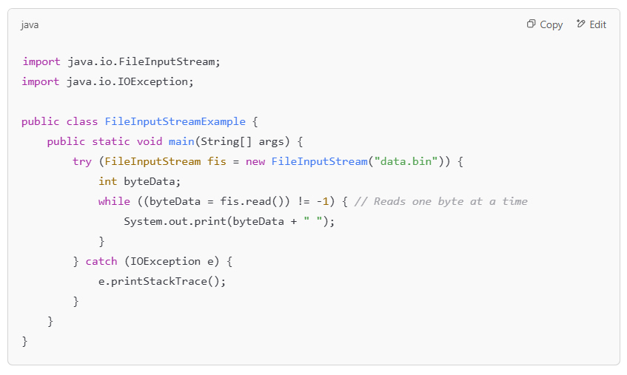
Input - Output
Does not differentiate between types (e.g., int, double, boolean).
Reads one byte at a time.

Slide 144
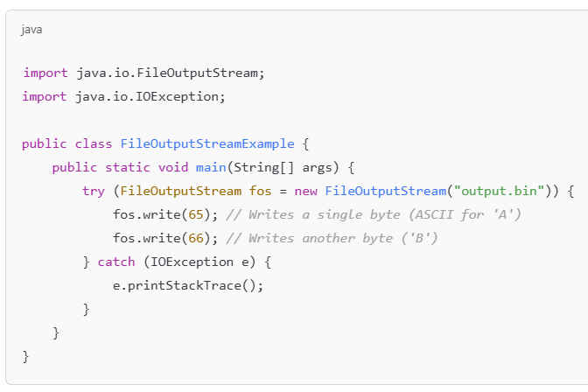
Input - Output
Writes one byte at a time.
No direct support for writing primitive types.

Slide 145
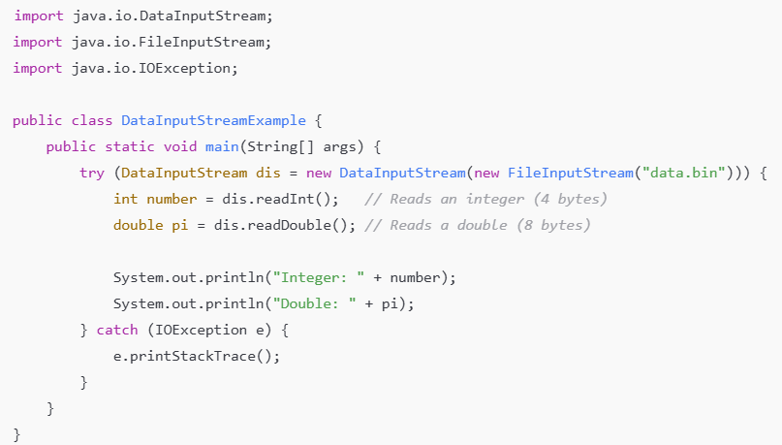
Input - Output
Reads structured binary data properly.
Must match the data writing order.

Slide 146
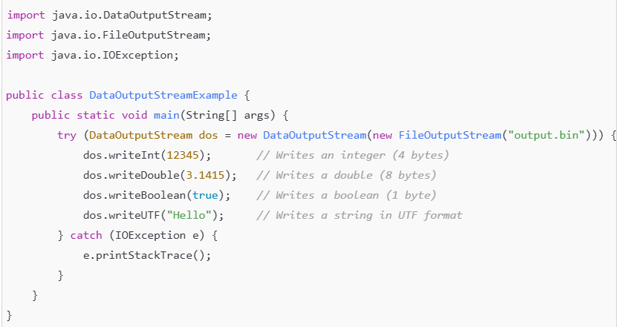
Input - Output
Efficiently writes structured data.
Order-sensitive: Must read data in the same order it was written.

Slide 147
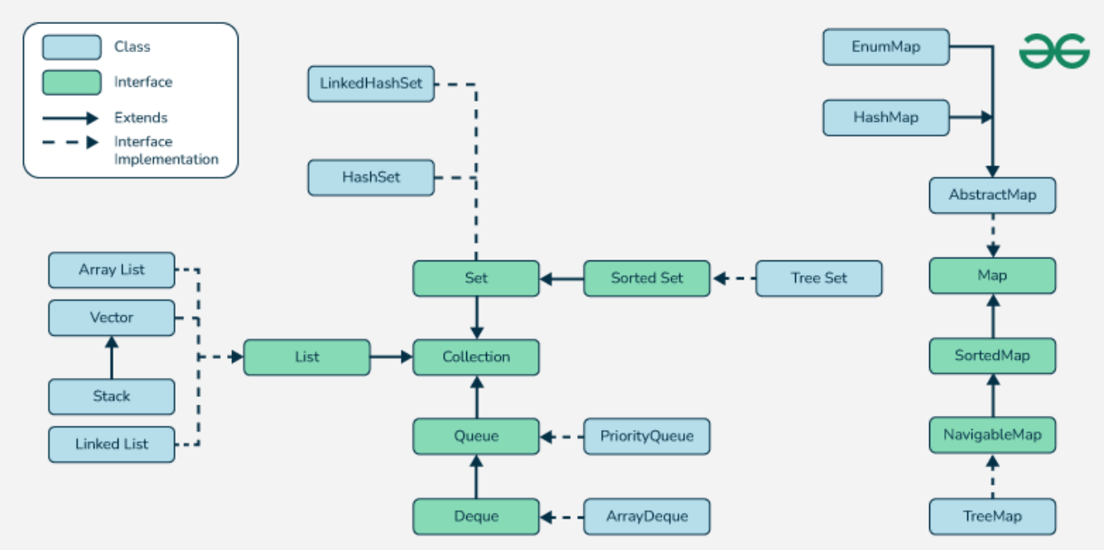
Java Collections Framework
Main Interfaces
Collection (Root interface)
List (Ordered, allows duplicates)
Set (Unordered, no duplicates)
Queue (FIFO order, processing elements in sequence)
Map (Key-Value pairs, no duplicate keys)

Slide 148
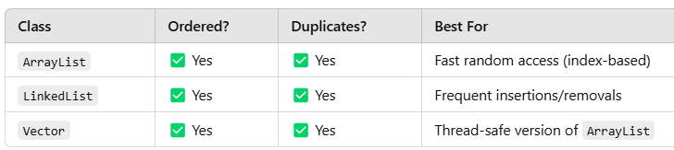
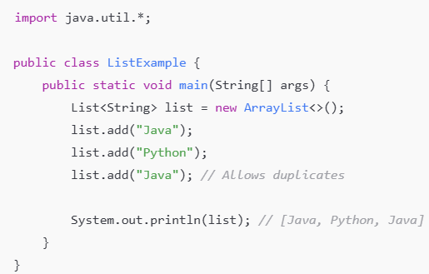
List Interface (Ordered, Duplicates Allowed)

Slide 149
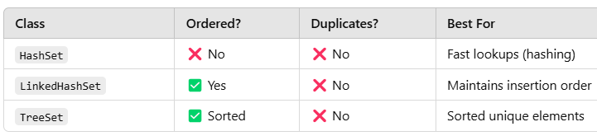
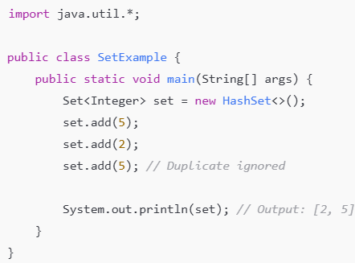
Set Interface (No Duplicates, Unordered)

Slide 150
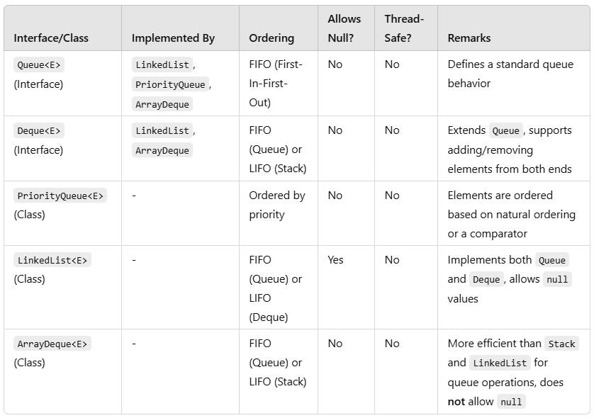
Queue Interface (FIFO)
A Queue processes elements in First In First Out (FIFO) order.

Slide 151
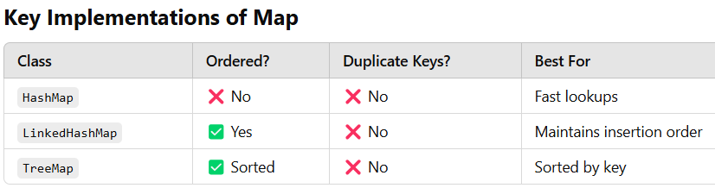
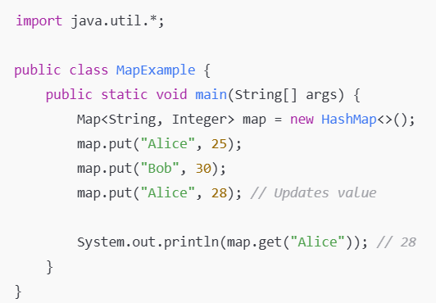
Map Interface (Key-Value Pairs)

Slide 152
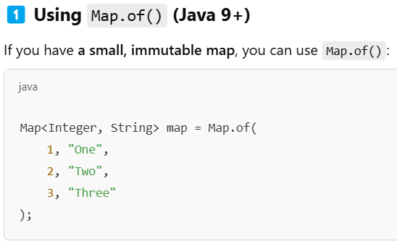
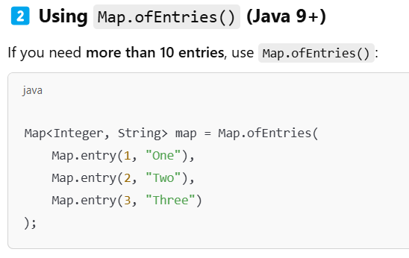
Populating Map in constructor

Slide 153
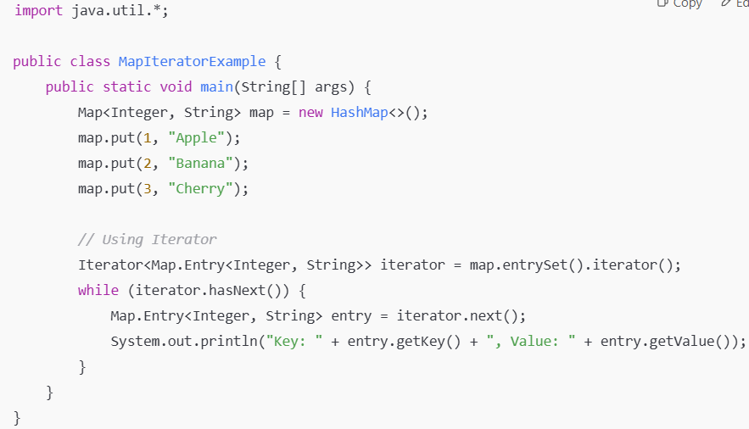
Iterating over Map entries using Iterator

Slide 154

Iterating over Map entries using Enhanced For Loop

Slide 155
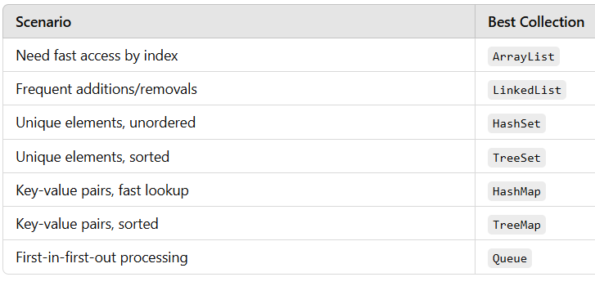
When to use which collection?

Slide 156
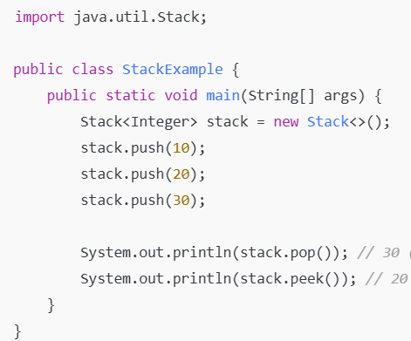
Stack (LIFO - Last In, First Out)
The Stack class extends Vector and follows the LIFO (Last In, First Out) principle.
Key Points:
Useful for recursive algorithms, backtracking, and undo/redo operations
Synchronized (slower than alternatives like ArrayDeque)
Should you use Stack?
No, unless you need thread safety
Use ArrayDeque instead for better
performance

Slide 157
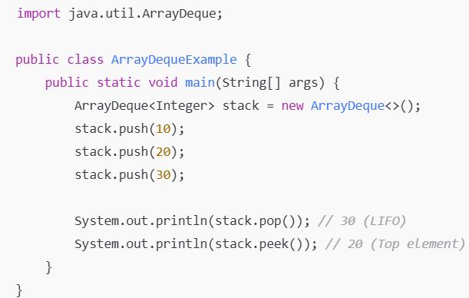
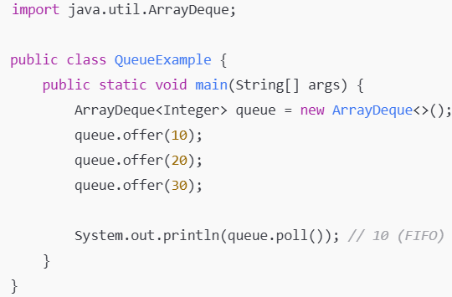
ArrayDeque (Better Alternative to Stack and Queue)
ArrayDeque (Double Ended Queue) can be used as both a stack and a queue. It is faster than Stack and LinkedList.
Key Points:
Faster than Stack (not synchronized)
Can be used as both Stack(LIFO) and Queue(FIFO)
No capacity restrictions

Slide 158
Java Collection Framework - Recap
List (Ordered, allows duplicates)
ArrayList
LinkedList
Vector (Legacy)
Stack (Extends Vector, LIFO behavior)
Queue (FIFO - First In, First Out)
PriorityQueue (Min-Heap by default)
ArrayDeque (Can act as both Queue & Stack)
LinkedList (Implements Queue too)
Set (Unique elements, no duplicates)
HashSet (Unordered, backed by HashMap)
LinkedHashSet (Maintains insertion order)
TreeSet (Sorted, backed by Red-Black Tree)
Map (Key-Value Pairs, No Duplicate Keys)
HashMap (Unordered, Fast Lookup)
LinkedHashMap (Insertion order maintained)
TreeMap (Sorted keys, Red-Black Tree)
Hashtable (Legacy, Thread-Safe)
Deque (Double-ended Queue, Can act as Stack)
ArrayDeque (Can function as Queue & Stack)
LinkedList (Also implements Deque)

Slide 159
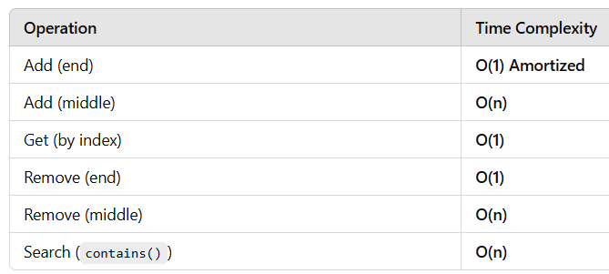
ArrayList
Key Features:
Dynamic Resizing – Unlike regular arrays, ArrayList grows dynamically when needed.
Indexed Access – Provides fast O(1) access to elements using indexes.
Allows Duplicates & Nulls – Can store duplicate elements and null values.
Maintains Insertion Order – The order of insertion is preserved.
Not Synchronized – It is not thread-safe, meaning multiple threads accessing it simultaneously may cause issues.
Performance Complexity

Slide 160
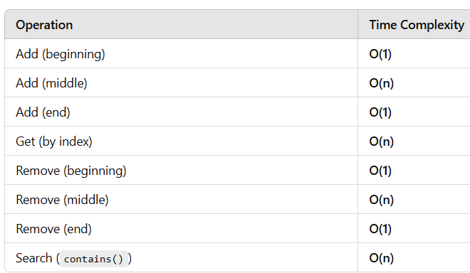
LinkedList
Key Features:
Doubly Linked List Implementation – Each node has a reference to both the previous and next node.
Efficient Insertions/Deletions – Insertions and deletions at the beginning/middle/end are faster compared to ArrayList (O(1) at head/tail).
Slower Random Access – Accessing an element by index is O(n), unlike ArrayList, which is O(1).
Implements Deque – Can be used as a Queue or Stack (supports FIFO & LIFO operations).
Allows Duplicates & Nulls – Can store duplicate elements and null values.
Maintains Insertion Order – Elements are stored in the order they are added.
Not Synchronized – Not thread-safe by default, requiring external synchronization.
Performance Complexity

Slide 161
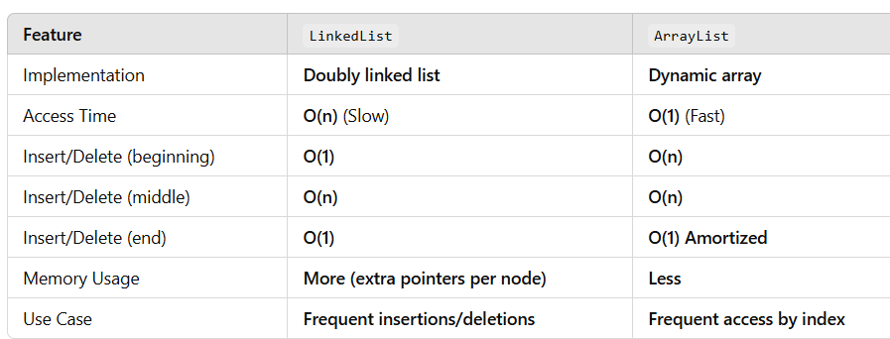
LinkedList vs. ArrayList

Slide 162


Generics in Java
Generics allow defining classes, interfaces, and methods with type parameters.
Provides type safety and removes the need for casting.
Without Generics
With Generics

Slide 163
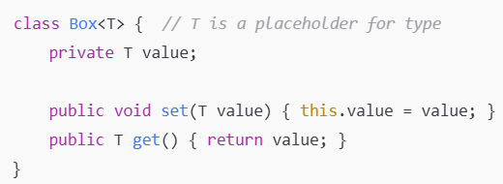

Generic Classes
Syntax
Usage
Benefits
Type Safety
Code Reusability
Removes Type Casting

Slide 164
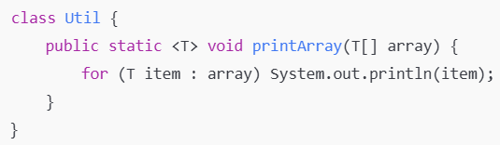

Generic Methods
Syntax
Usage
Key Points
<T> before return type defines a new type parameter.
Works with any type passed to it.

Slide 165
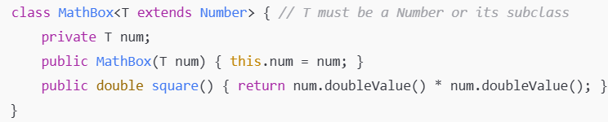

Bounded Type Parameters (extends, super)
Syntax
Usage
<T super Integer>
<T extends Number>

Slide 166



Wildcards (?)
Syntax
Allows any type, but NO MODIFICATION

Slide 167
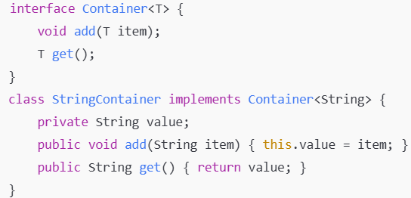
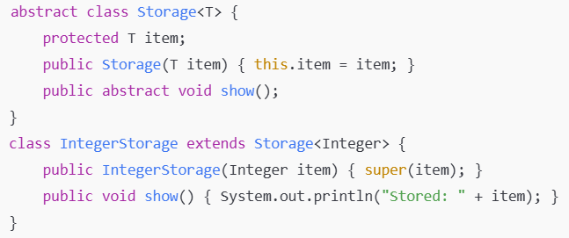
Generic Interface and Abstract Class

Slide 168
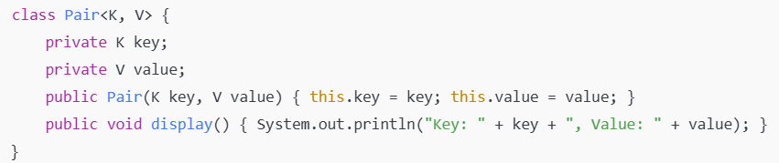

Multiple Type Parameters
Syntax
Usage

Slide 169
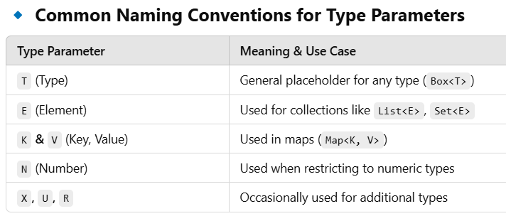
Which letters to use?

Slide 170
Anonymous Inner Class
Used when you need a one-time implementation of an interface or abstract class.

Slide 171
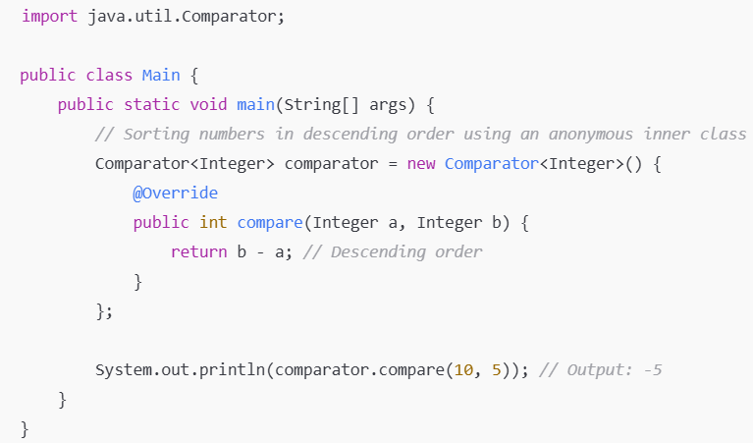
Functional Interface
Definition: A functional interface is an interface with exactly one abstract method.
Use Case: Used for functional programming, lambda expressions, and method references.
Syntax: Instead of new Interface() { ... }, we use a lambda expression (parameters) -> { body }.

Slide 172
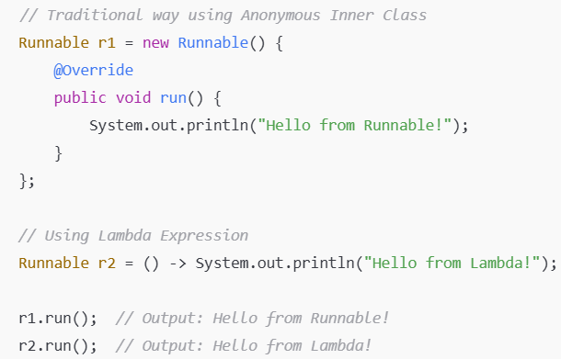
Lambda Expressions
Lambda expressions were introduced in Java 8 to enable functional programming and provide a concise way to implement functional interfaces.
Syntax: (parameters) -> {expression or statements};

Slide 173

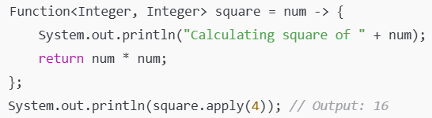
Lambda Expression Variations
No Parameters
Single Parameter (Parentheses Optional)
Multiple Parameters
Block Body with Multiple Statements

Slide 174
Method Reference
A lambda expression defines an anonymous function with a specific behavior, while a method reference is a more concise way to refer to an existing method that performs the same function.
Using a Lambda Expression
Equivalent to using Method Reference

Slide 175
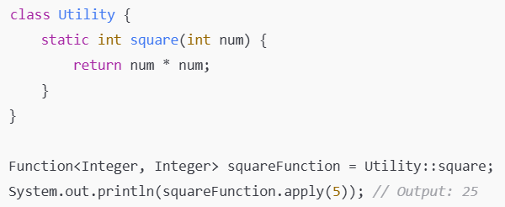
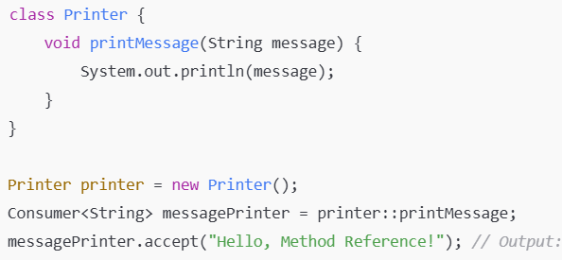
Method Reference
Reference to a static method
Reference to an instance method

Slide 176
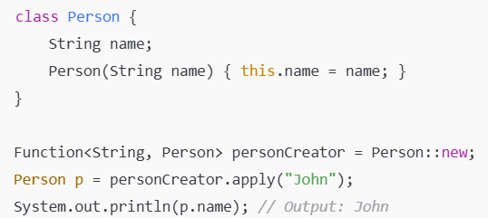
Method Reference
3. Reference to a Constructor
Lambda expressions and method references serve the same purpose.
Method references are a shorthand for simple lambda expressions.
If the lambda only calls an existing method, replace it with a method reference for better readability!

Slide 177
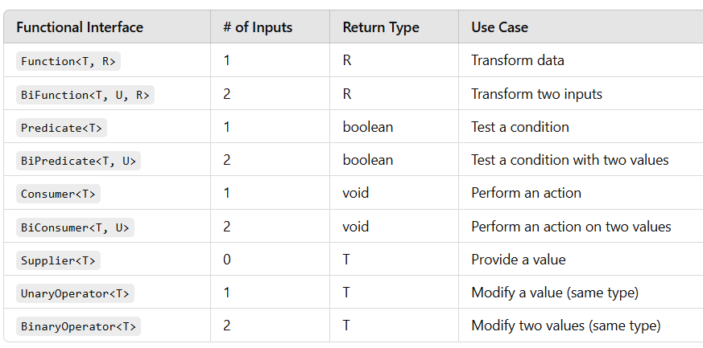
Common Functional Interfaces in Java
Use Function<T, R> when you transform one value into another.
Use Predicate<T> when you test a condition and return true or false.
Use Consumer<T> when you perform an action but don’t return anything.
Use Supplier<T> when you generate or retrieve a value with no input.
Use UnaryOperator<T> or BinaryOperator<T> for same-type operations.

Slide 178
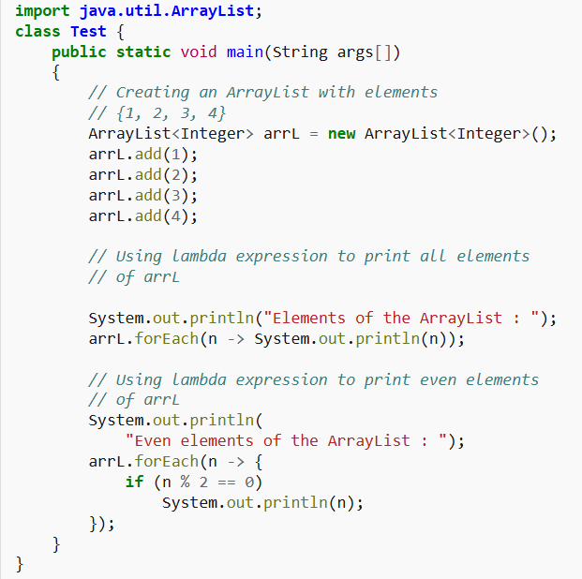
Lambda Expression Examples

Slide 179
Lambda Expression Examples
public class Main {
public static void applyOperation(List<Integer> numbers, Function<Integer, Integer> operation) {
for (int i = 0; i < numbers.size(); i++) {
numbers.set(i, operation.apply(numbers.get(i))); // Apply the passed function
}
}
public static void main(String[] args) {
List<Integer> numbers = new ArrayList<>(Arrays.asList(1, 2, 3, 4));
// Passing different operations as functions
applyOperation(numbers, n -> n * n); // Square numbers
System.out.println(numbers); // Output: [1, 4, 9, 16]
applyOperation(numbers, n -> n * 2); // Double numbers
System.out.println(numbers); // Output: [2, 8, 18, 32]
applyOperation(numbers, n -> -n); // Negate numbers
System.out.println(numbers); // Output: [-2, -8, -18, -32]
}
}

Slide 180
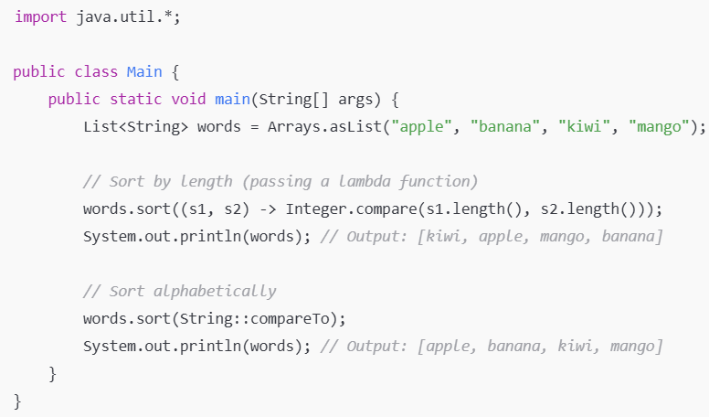
Lambda Expression Examples

Slide 181
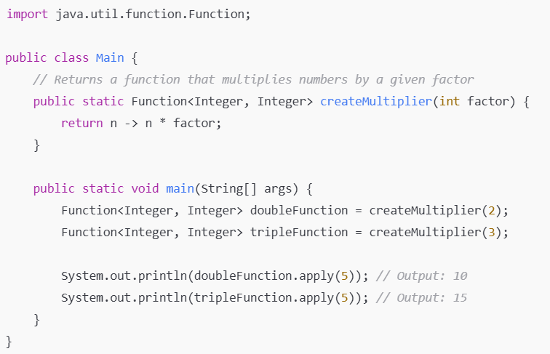
Lambda Expression Examples

Slide 182
Lambda Expression Examples
import java.util.*;
import java.util.function.Predicate;
public class Main {
public static List<Integer> filterNumbers(List<Integer> numbers, Predicate<Integer> condition) {
List<Integer> result = new ArrayList<>();
for (Integer num : numbers) {
if (condition.test(num)) { // Apply the condition function
result.add(num);
}
}
return result;
}
public static void main(String[] args) {
List<Integer> numbers = Arrays.asList(1, 2, 3, 4, 5, 6);
// Passing different predicates (conditions)
List<Integer> evenNumbers = filterNumbers(numbers, n -> n % 2 == 0);
System.out.println(evenNumbers); // Output: [2, 4, 6]
List<Integer> greaterThanThree = filterNumbers(numbers, n -> n > 3);
System.out.println(greaterThanThree); // Output: [4, 5, 6]
}
}

